Slide 1
Smart Door Lock Project
</
/>
Here is The Summary of The Project

Slide 2
<Content> </Content>
Table of Content
<ul>
<li> Hardware Components </li>
<li> Programming Languages & Frameworks </li>
<li> Tutorial </li>
<li> Project References </li>
</ul>

Slide 3







</ Hardware Components
Raspberry Pi
Pi Camera
Smart Door Lock System
PIR Sensor || Piezoelectric Sensor
Solenoid Lock
Micro SD Card
Jumper Wire
Relay Module

Slide 4
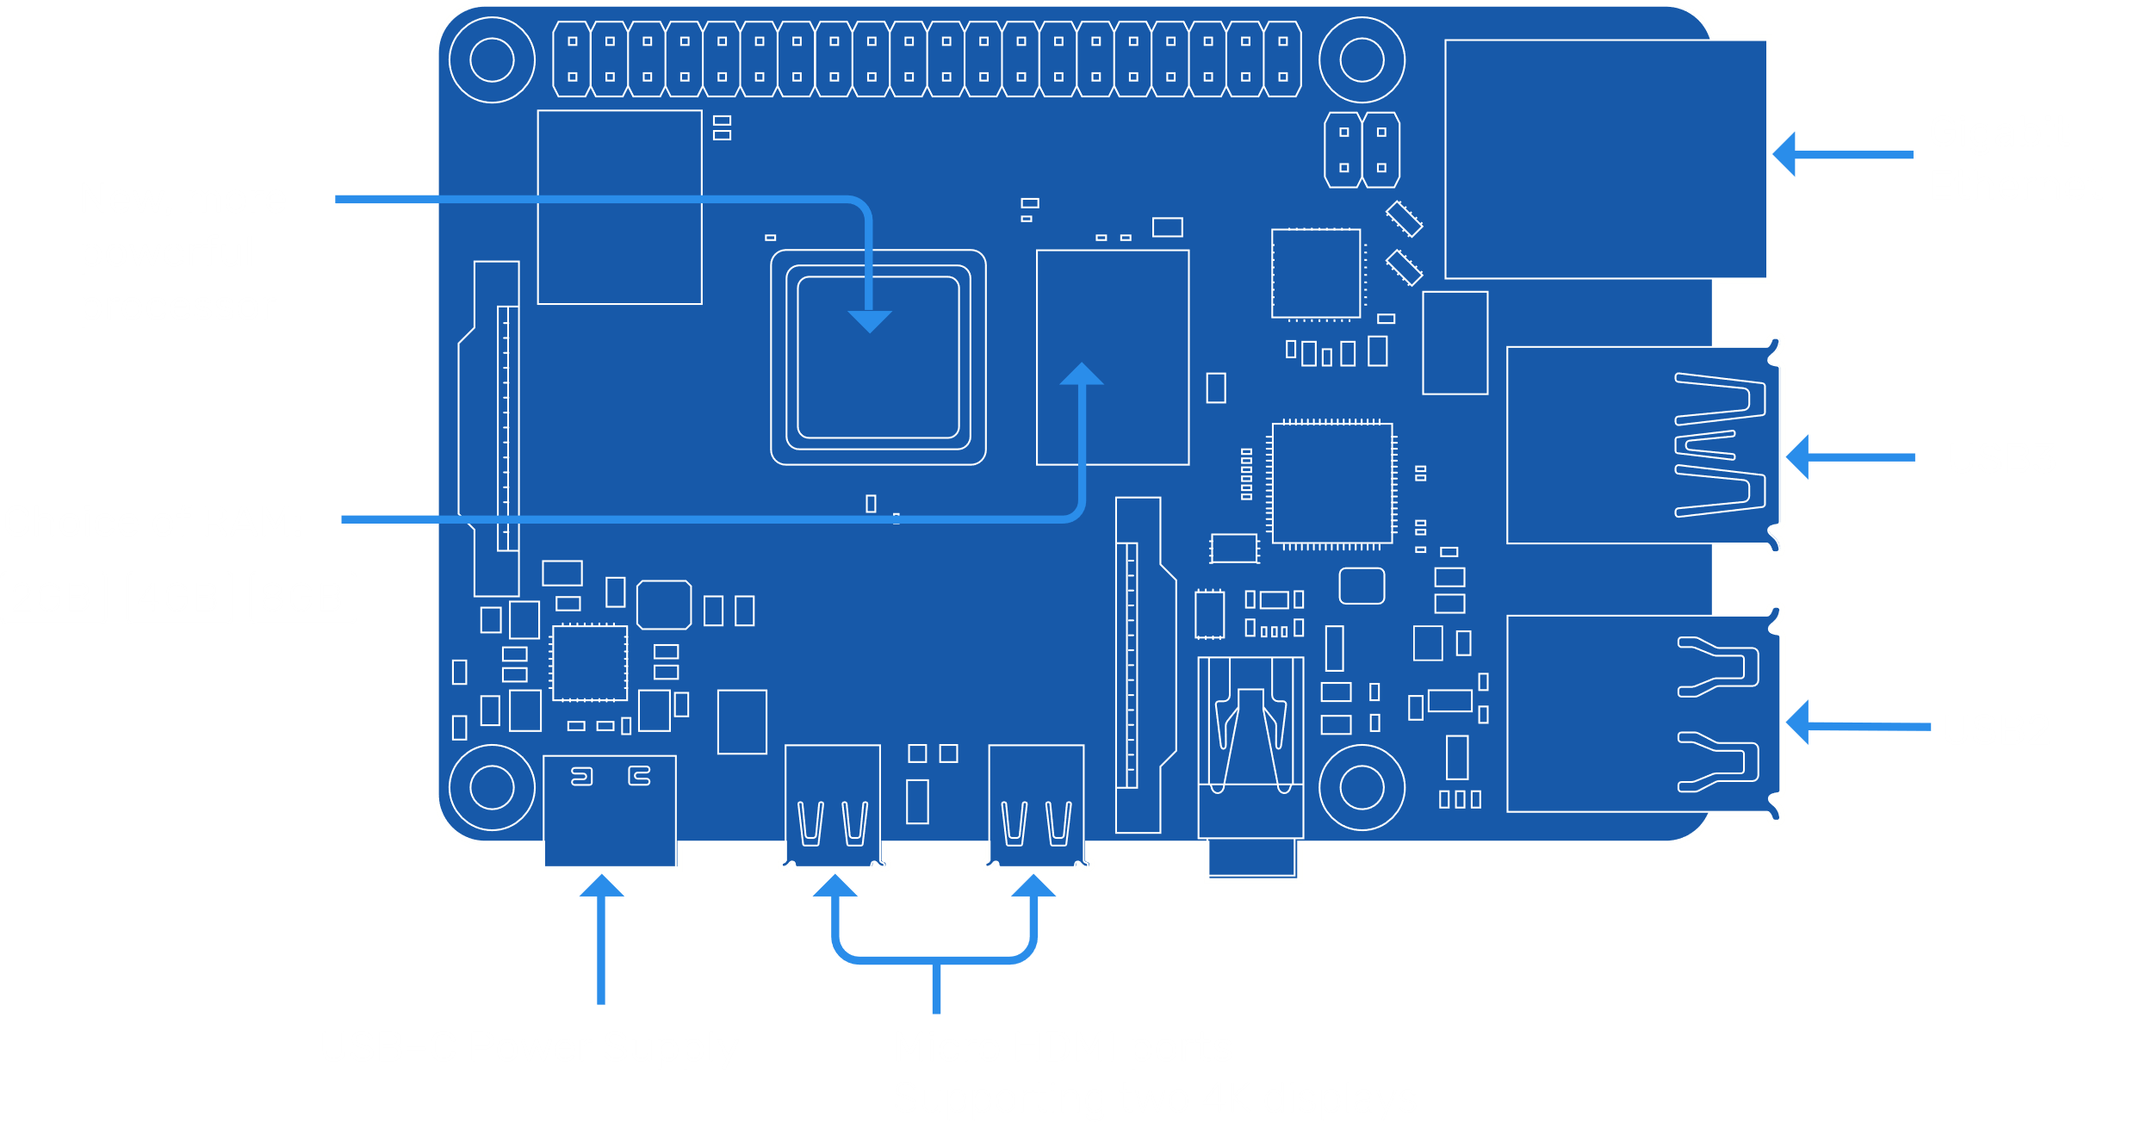
</ Raspberry Pi 4 B
Raspberry Pi standard 40 pin GPIO header (fully backwards compatible with previous boards)
- 2.4 GHz and 5.0 GHz IEEE 802.11ac
wireless, Bluetooth 5.0
2-lane MIPI DSI display port
2-lane MIPI CSI camera port
< View All Info >

Slide 5
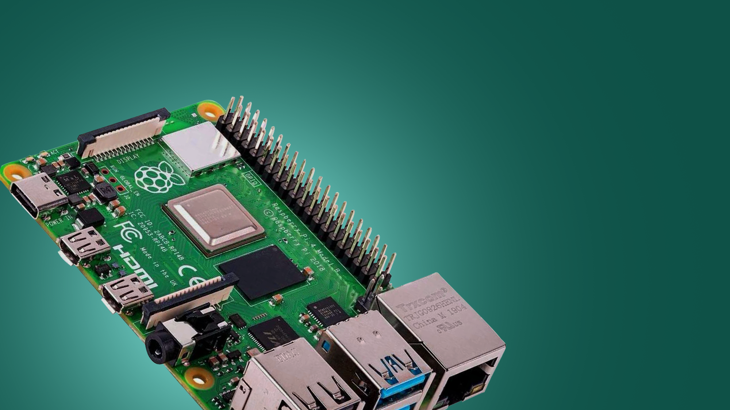
</ Raspberry Pi 4 B
The Raspberry Pi 4 Model B was released in June 2019 with a 1.5 GHz 64-bit quad core ARM Cortex-A72 processor, on-board 802.11ac Wi-Fi, Bluetooth 5, full gigabit Ethernet (throughput not limited), two USB 2.0 ports, two USB 3.0 ports, 1–8 GB of RAM, and dual-monitor support via a pair of micro HDMI (HDMI Type D)

Slide 6
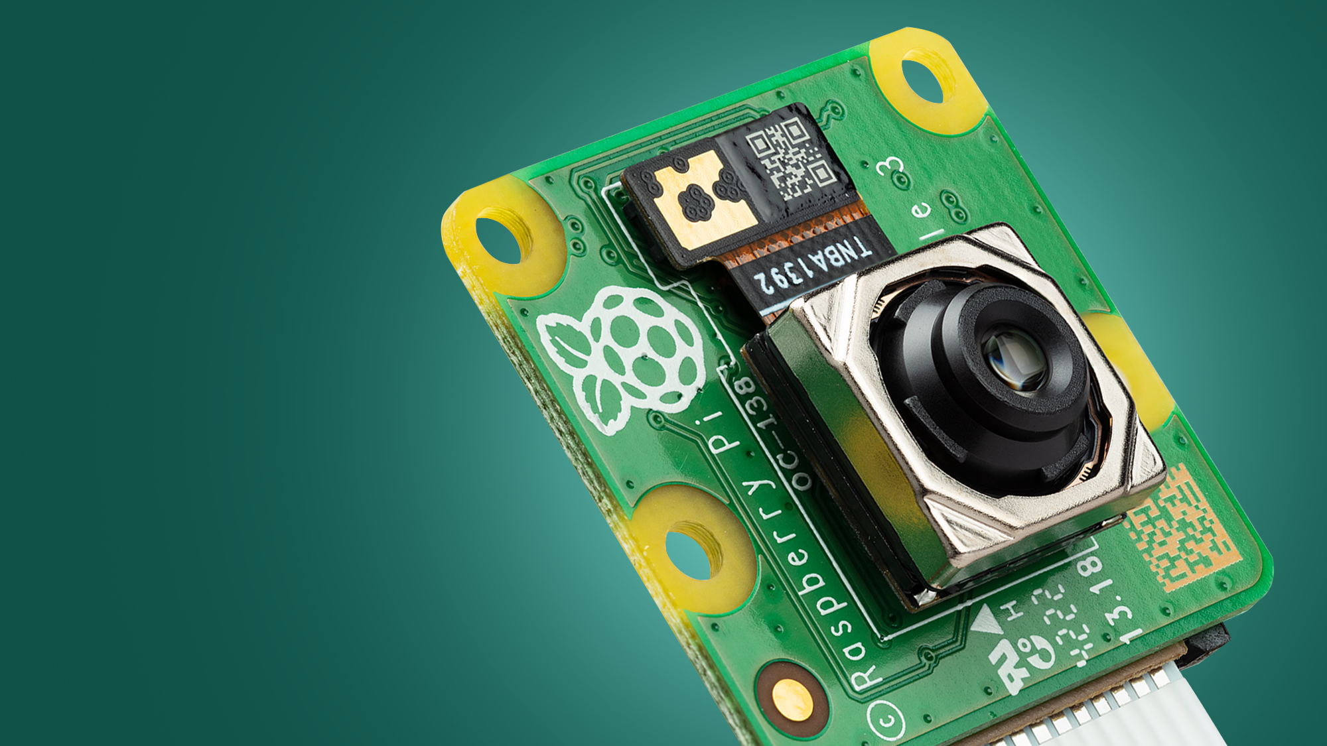
</ Pi Camera
The Raspberry Pi Camera Module 2 replaced the original Camera Module in April 2016. The v2 Camera Module has a Sony IMX219 8-megapixel sensor (compared to the 5-megapixel OmniVision OV5647 sensor of the original camera)

Slide 7
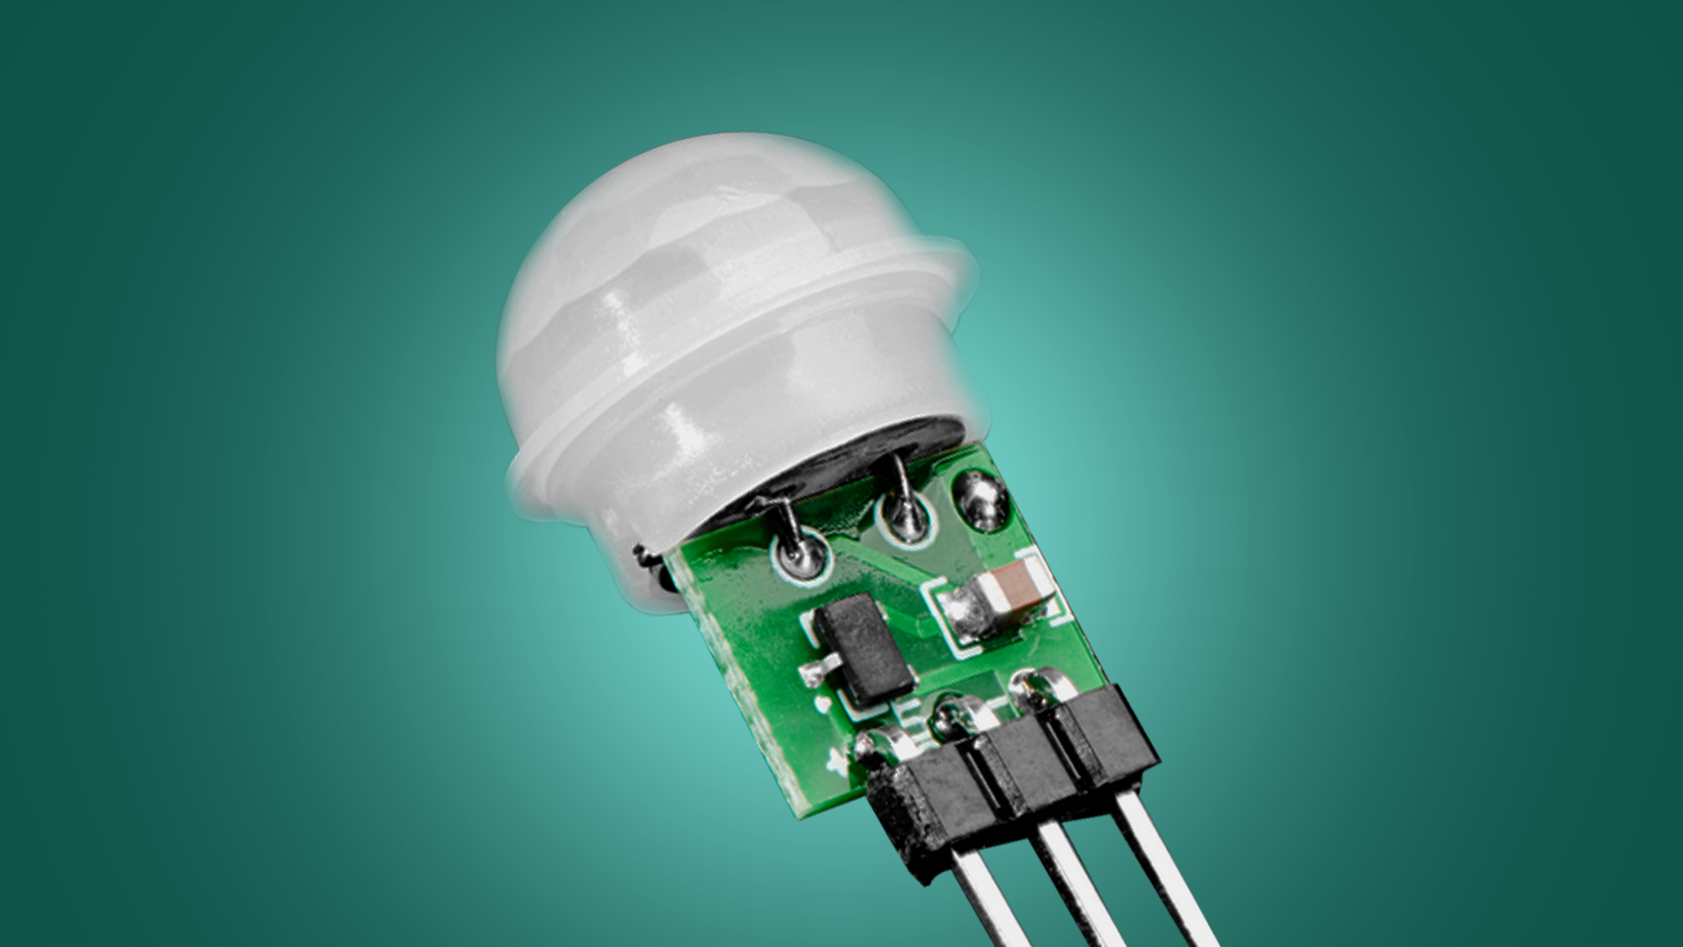
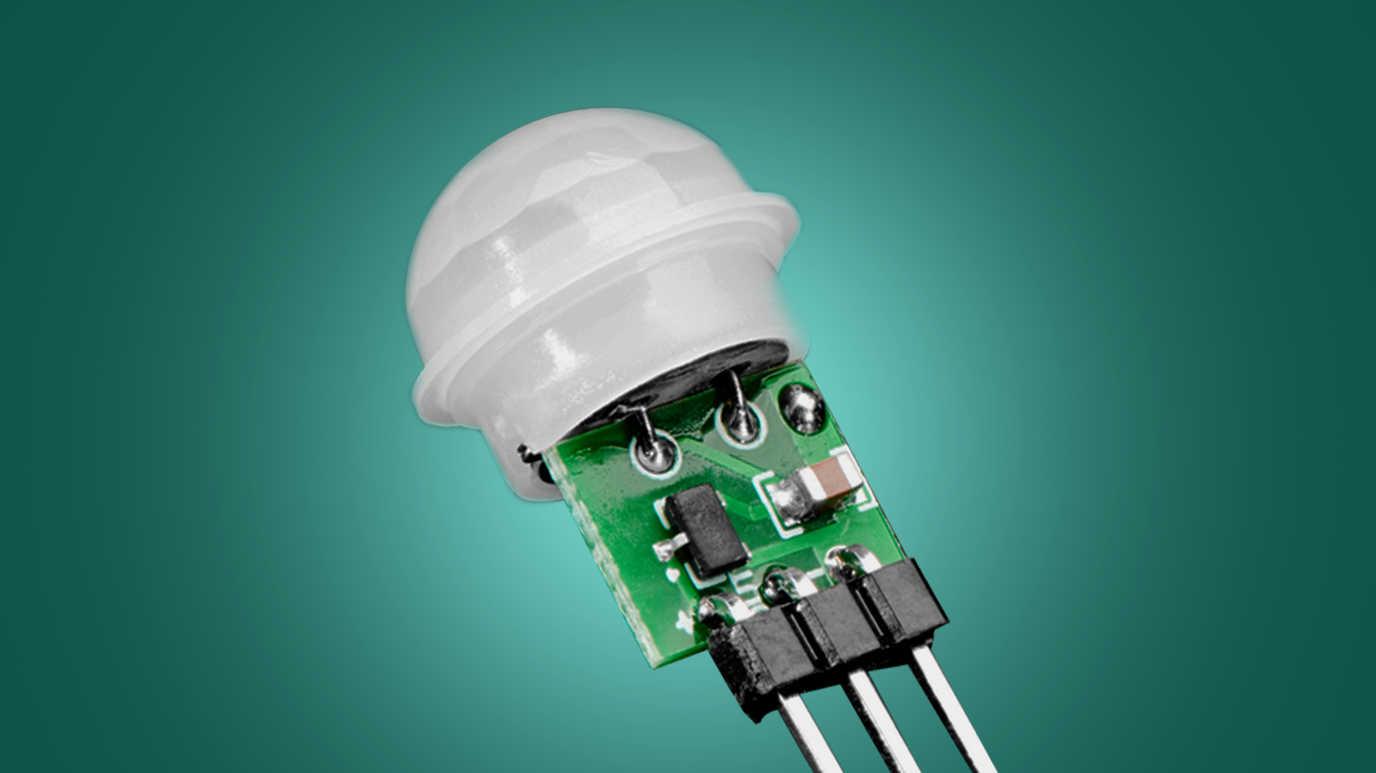
tA passive infrared sensor is an electronic sensor that measures infrared light radiating from objects in its field of view. They are most often used in PIR-based motion detectors. PIR sensors are commonly used in security alarms and automatic lighting applications.
</ PIR Sensor
They have lower sensitivity and less coverage compare to microwave sensors.
It does not operate greater than 35 degree C
It works effectively in LOS
A passive infrared sensor is an electronic sensor that measures infrared light radiating from objects in its field of view. They are most often used in PIR-based motion detectors. PIR sensors are commonly used in security alarms and automatic lighting applications.

Slide 8
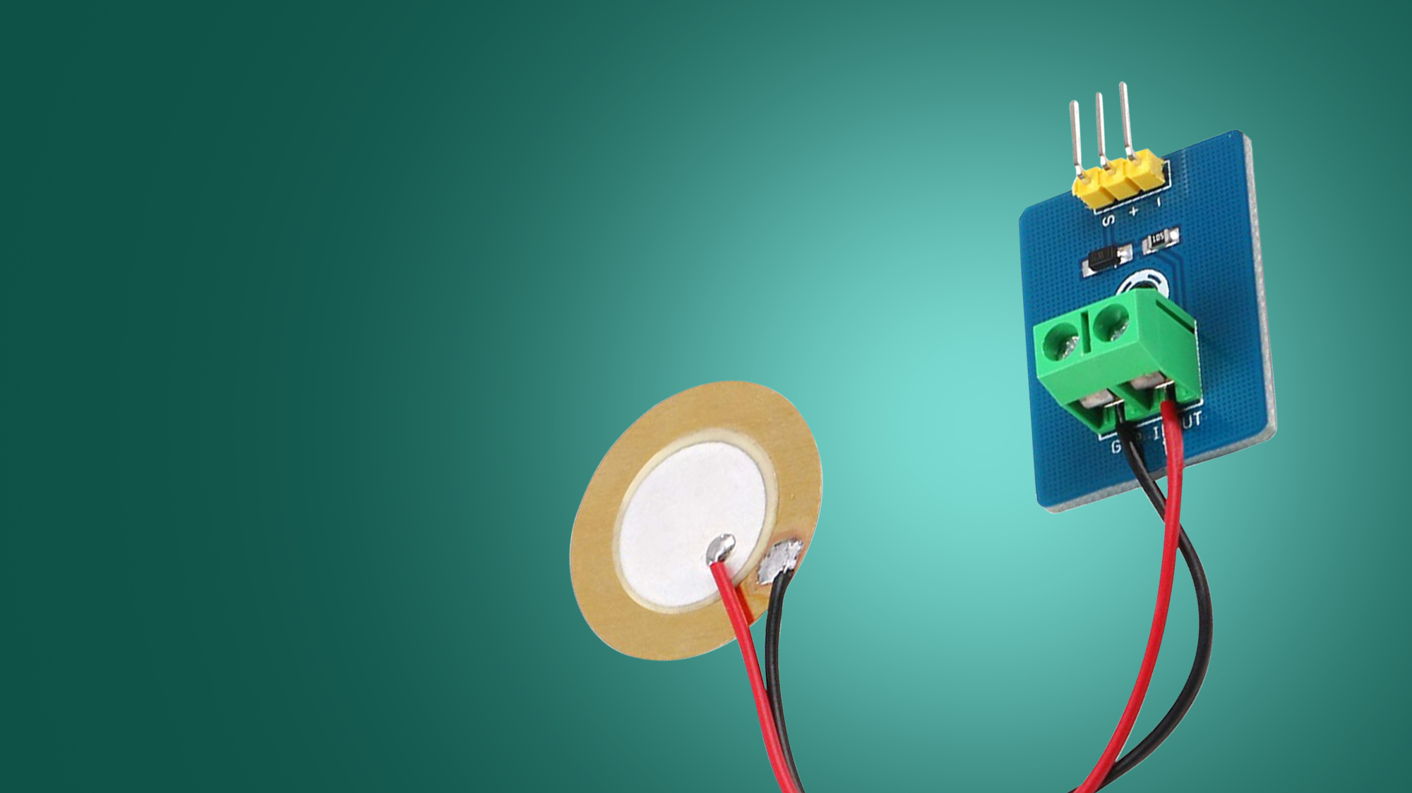
</ Piezoelectric Sensor
A piezoelectric sensor is a device that uses the piezoelectric effect to measure changes in pressure, acceleration, temperature, strain, or force by converting them to an electrical charge. The prefix piezo- is Greek for 'press' or 'squeeze'
The piezoelectric transducer has good frequency response.
It is available in desired shape.
It has rugged construction.
It has negligible phase shift.
It is small in size.
It offer high output that be measured in the electronic circuit.

Slide 9
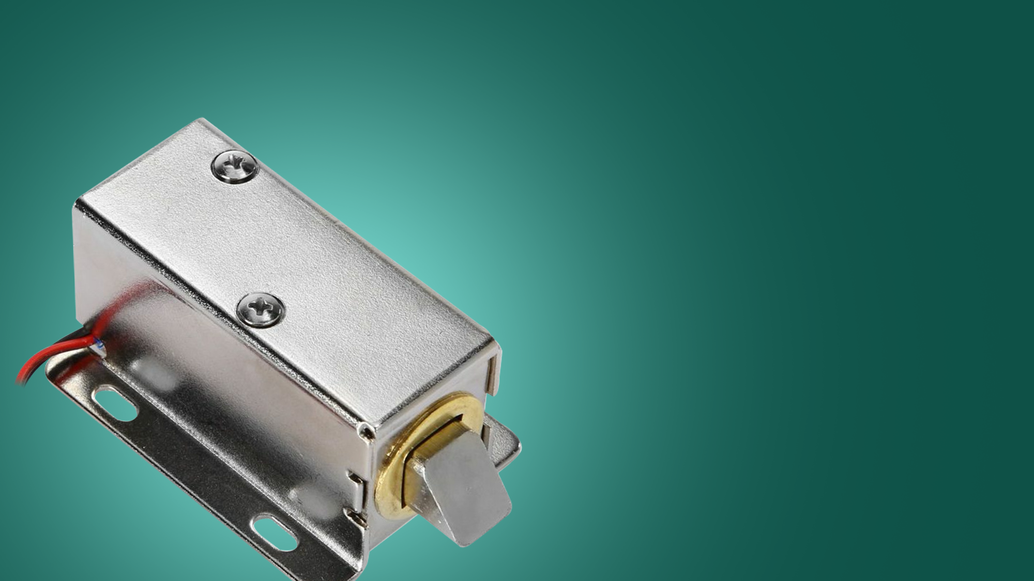
</ Solenoid Lock
The solenoid lock denotes a latch for electrical locking and unlocking. It is available in unlocking in the power-on mode type, and locking and keeping in the power-on mode type, which can be used selectively for situations. The power-on unlocking type enables unlocking only while the solenoid is powered on.

Slide 10
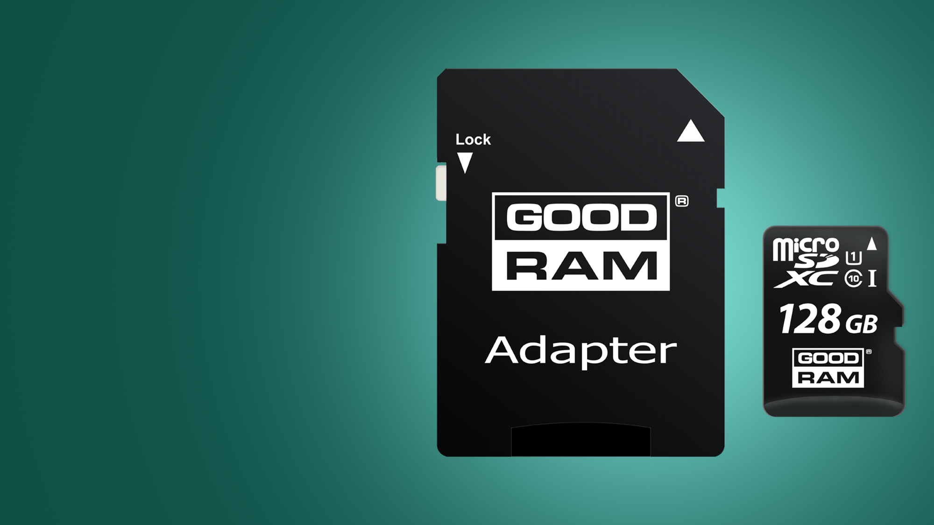
</Micro Sd Card
We Need Micro Sd Card To Use It as Storage For The System
It will Cary out The Software and Store The Taken Images
Storage of 128 GB Will be The Optimal Solution for This System

Slide 11
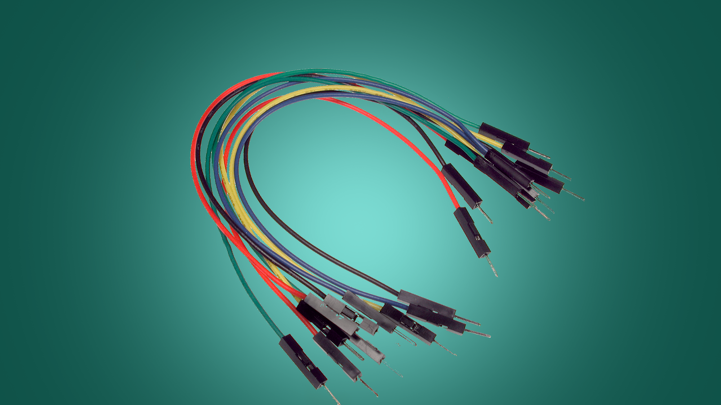
</ Jumper Wires
The Jumper Wires is Used For Connecting The Components Together and Control How They Interact Together

Slide 12
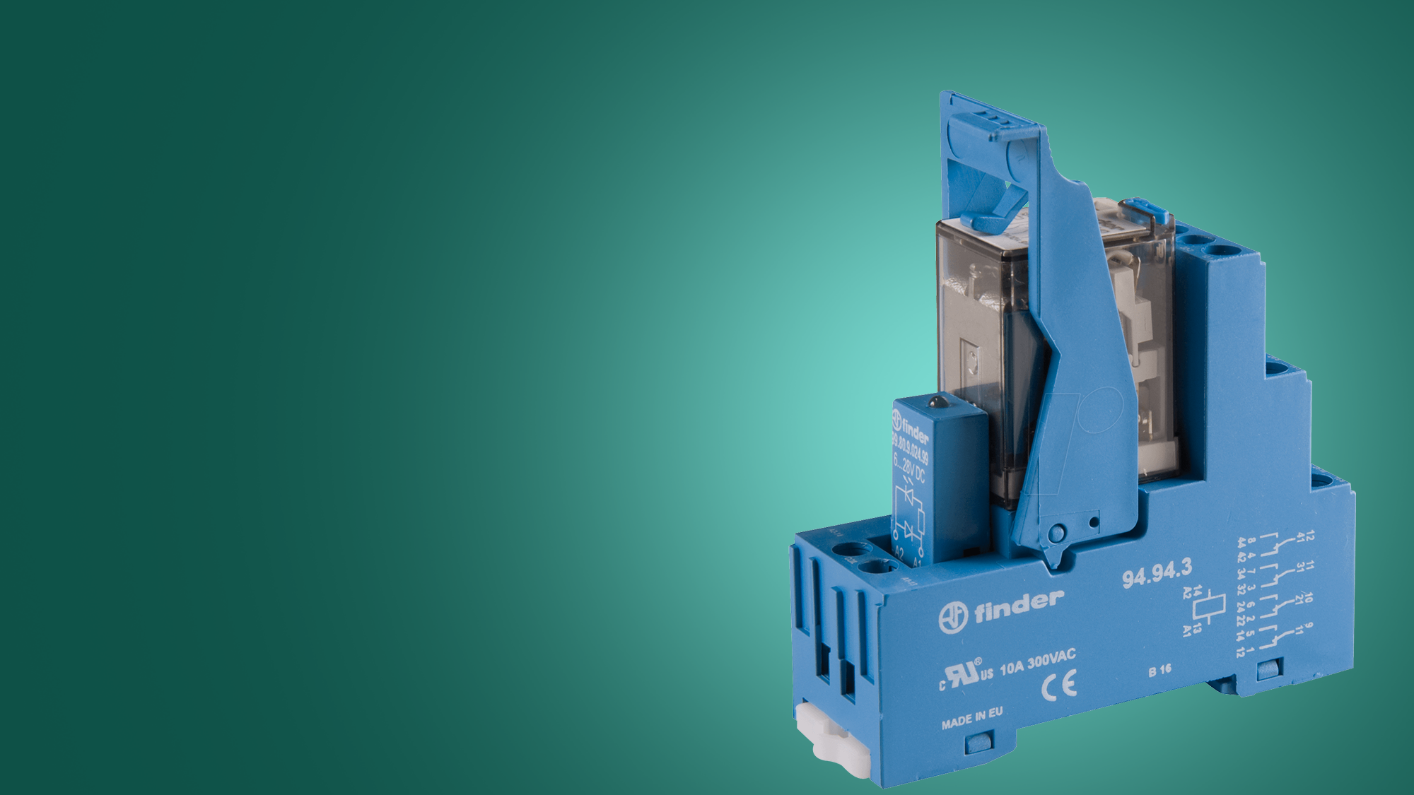
</ Relay Module
A power relay module is an electrical switch that is operated by an electromagnet. The electromagnet is activated by a separate low-power signal from a micro controller. When activated, the electromagnet pulls to either open or close an electrical circuit.

Slide 13





</ Programming & Software
Flutter
{ }
Python
{ }
FrameWork For Deveolpeing Mobile App
Programming Language
Firebase
Raspberrry Pi OS
{ }
{ }
Backend Cloud Computing System
The Image of the OS To Run System

Slide 14
</ Flutter
Flutter is an open-source UI software development kit created by Google. It is used to develop cross platform applications from a single codebase for any web browser, Fuchsia, Android, iOS, Linux, macOS, and Windows. First described in 2015, Flutter was released in May 2017
It Will Be Used To Develop Cross Platform App To Use The Mobile App On Both Android and IOS
It also Provide Great Support For Connection Firebase Services

Slide 15
</ Python
Python is a high-level, general-purpose programming language. Its design philosophy emphasizes code readability with the use of significant indentation. Python is dynamically typed and garbage-collected. It supports multiple programming paradigms, including structured, object-oriented and functional programming
Python have A Huge Support For Raspberry Pi With a lot of Packages Supported for Raspberry Pi
It also Provide Support For Connection Firebase Services

Slide 16
</ Firebase
Firebase, Inc. is a set of backend cloud computing services and application development platforms provided by Google. It hosts databases, services, authentication, and integration for a variety of applications, including Android, iOS, JavaScript, Node.js, Java, Unity, PHP, and C++.
It Provider Auth Service { Firebase Auth }
It Provider Real Time Database Service { Firebase Realtime Database }
It Provider Storage Service { Firebase Storage }
This Services Fit The Use of the System That Provide Realtime Actions , Cloud Storage and Multilabel Auth Methods

Slide 17
</ Raspberry Pi OS
Raspberry Pi OS is a Unix-like operating system based on the Debian Linux distribution for the Raspberry Pi family of compact single-board computers. First developed independently in 2012, it has been produced as the primary operating system for these boards since 2013, distributed by the Raspberry Pi Foundation
It Require Raspberry Pi Imager to Install the OS Image
Raspberry Pi OS is the Optimal Choice for Using Raspberry Pi

Slide 18
</ Tutoriala
</ How To Develop Raspberry Pi >
</ Flutter Mobile Development >
</ Python Programming Language >

Slide 19
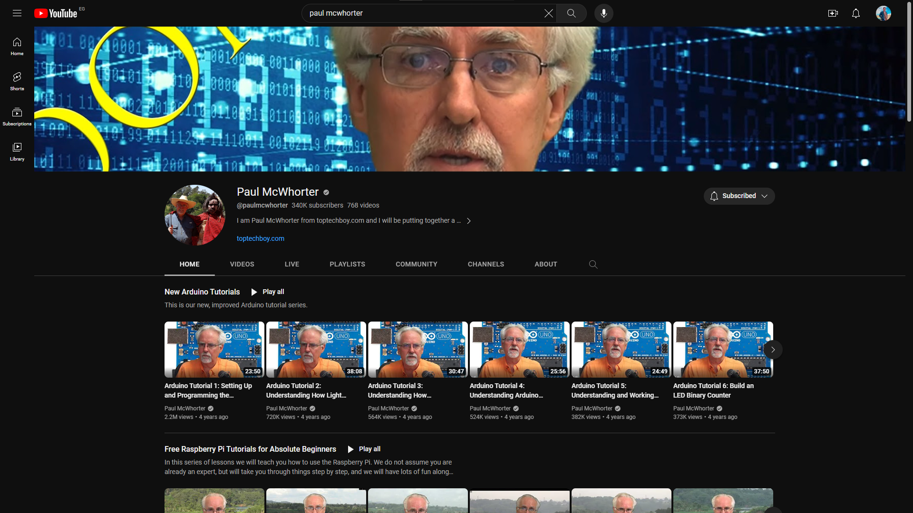
</ Paul McWhorter
Provides A Great Raspberry Pi Course Help To Learn Most About Raspberry Pi From Scratch
He also Provide Course To Learn Python
</ View Chanel >

Slide 20
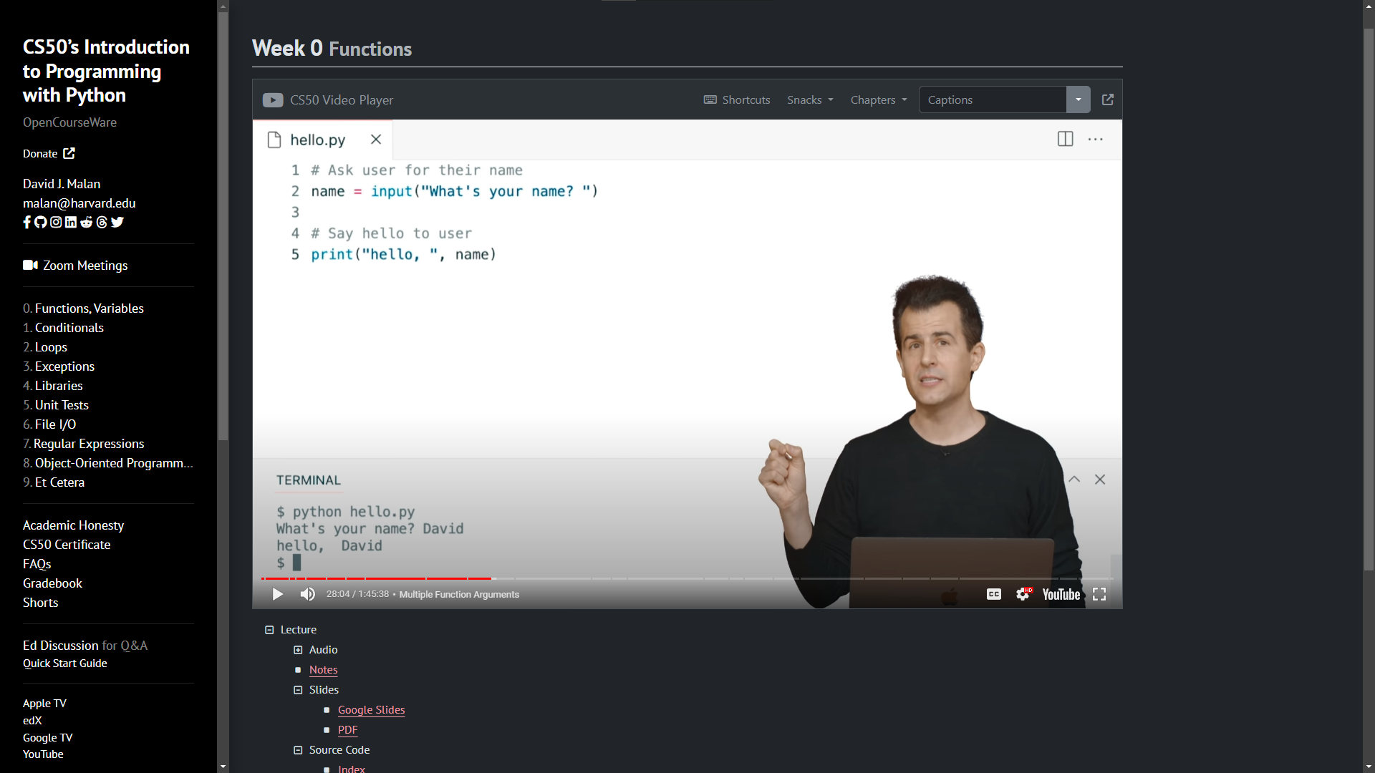
</ Harvard CS50 Python
An introduction to programming using a language called Python. Learn how to read and write code as well as how to test and “debug” it. Designed for students with or without prior programming experience
</ View Chanel >

Slide 21
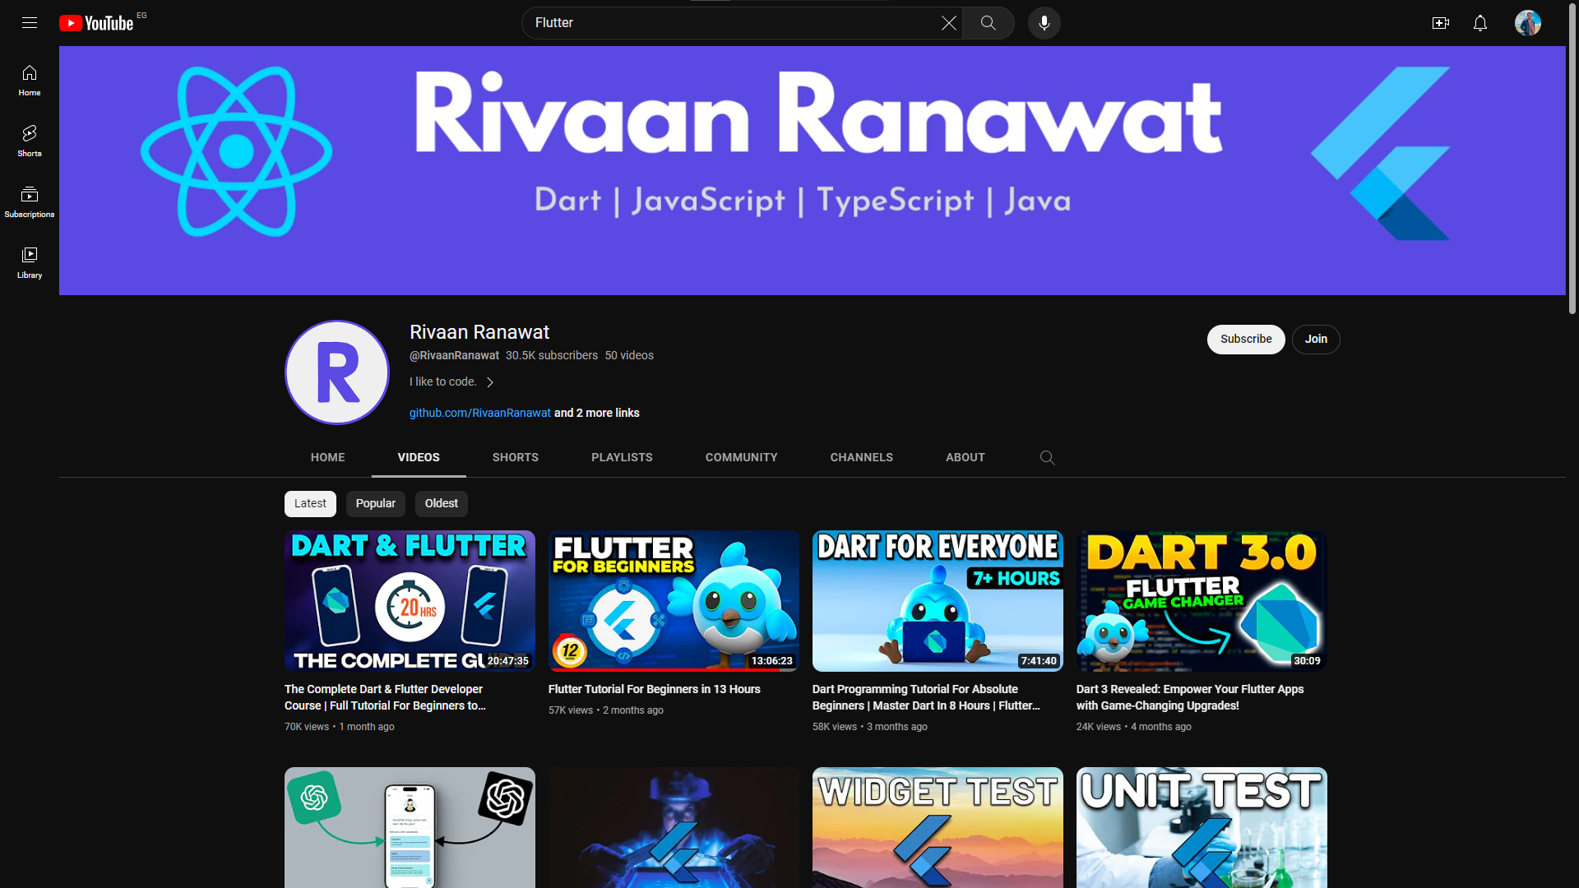
</ Rivaan Ranawat
Rivaan Ranawat Is a YouTube Channel That Provide Helpful Tutorials For Flutter and Dart Programming Language
</ View Chanel >

Slide 22
</ References Projects
IoT Based Home Security System Using Raspberry Pi-3
Smart Doorbell Using Raspberry Pi and Pi Camera
Security System for Visitor Validation at Entrance using Raspberry Pi and Elliptical Curve Digital Signature
IoT Based Smart Doorbell Using Raspberry Pi
Raspberry Pi based Smart Home for Deployment in the Smart Grid

Slide 23
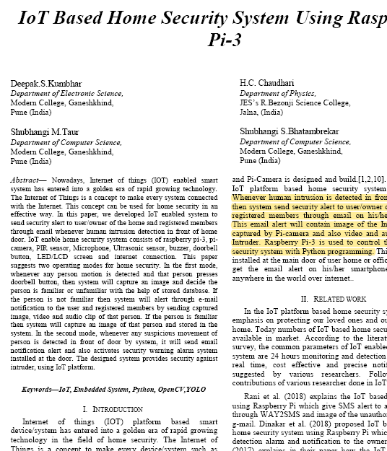
</IoT Based Home Security System Using Raspberry Pi-3
IoT Based Home Security System Using Raspberry Pi-3! This article provides valuable insights on how to use Raspberry Pi-3 to create a secure home environment.
This System Recognize any Visitor When it Near To the Door Using PIR Sensor When Visitor Come Closer To the Door The System Capture an Image Using The Pi Camera Which Installed To The Raspberry Pi Then the Raspberry Pi Store The Image on Micro SD and Analysis The Image Using YOLO algorithm
After Analyzing The Image The System Send Email With The Image and recorded Video and Audio To the Owner

Slide 24
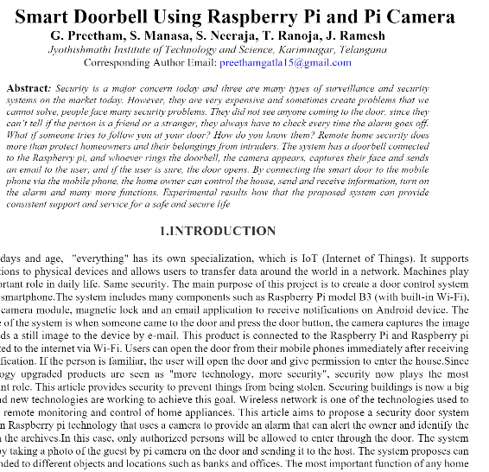
</Smart Doorbell Using Raspberry Pi and Pi Camera
Smart Doorbell Using Raspberry Pi and Pi Camera
This article presents a low-cost Raspberry Pi device for home automation, utilizing a sensor to detect physical movement and record visitor images. The project uses face recognition systems like Markov Hidden Model and geometric matching for face detection, ensuring accurate and practical applications.
The Raspberry Pi receives a doorbell signal and passes it to a camera, which captures an image and checks if it exists in the database. then the user decides whether to let him in or not.
will use : Raspberry pi - power supply - pi camera - internet - door bell - solenoid lock - phone - Application

Slide 25
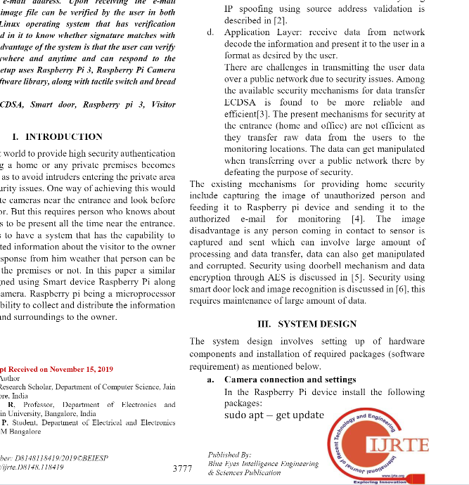
</Security System for Visitor Validation at Entrance using Raspberry Pi and Elliptical Curve Digital Signature
Hardware setup
Connecting the Raspberry Pi’s general-purpose input output ports (GPIO) to a tactile switch We connect one side of the switch to an input pin on the Raspberry Pi using pin 18 general purpose input output ports (GPIO) The other side of the switch is connected to ground using pin 6 using jumper wires. when the button is pressed program runs that reads the state of the button
conclusion
This paper introduces an IoT security mechanism using ECDSA for reliable and cost-effective data verification. It utilizes the MIRACL crypto library , enhancing existing methods with digital signatures for data integrity through private and public key verification.

Slide 26
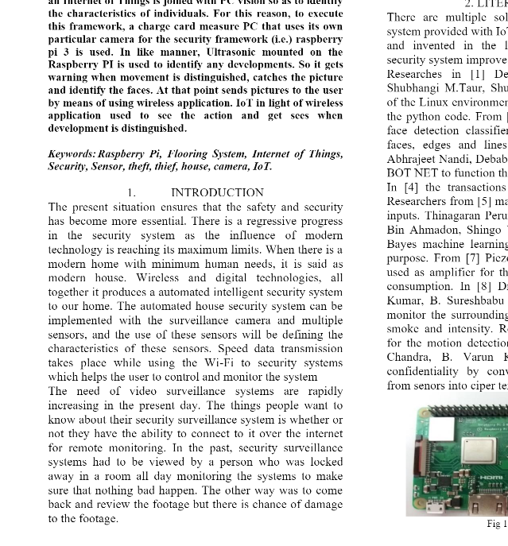
</ IoT Based Smart Doorbell Using Raspberry Pi
This system ensures security when the occupants leave home; it activates when needed, transmitting information about potential intruders over IoT.
The proposed system
uses switch sensors placed under floor tiles to detect pressure, enhancing efficiency and accuracy. These sensors can measure pressure on tiles, avoiding temperature constraints, and can be executed using Python scripts using OpenCV.
Collecting input signal from the sensor to Raspberry pi Controller.
Generating rotation in the servo motor based on the signal received from the raspberry Pi
Capturing Video frames and transmitting to the user over network and enabling alarm

Slide 27
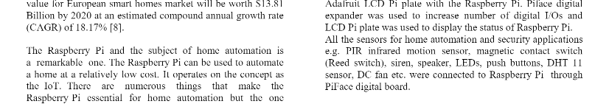
</ Raspberry Pi based Smart Home for Deployment in the Smart Grid
This system triggers an email notification with a "Door Open" message and a picture when a door with a reed switch is opened, alerting the owner of the breach and sounding an alarm. Configuration details are managed via Python scripts.

